Slide 1

Crowdfunding for Education
Karthick B
Jesu Pandian J
Guided by : Mr. Rajesh Kumar S

Slide 2
ABSTRACT
Crowdfunding for education works within an organization to provide financial support to people among them as Peer to Peer donation.
Works as a community in an organization which leads to proper way to help each other in critical financial situations.
Current student will be the future donors of the unstoppable community working towards the solution on educational poverty.
Suggestions are made for organizations to develop communication that creates a humanitarianism culture and engages students as potential donors .
Thus, using crowdfunding as a financial resource for educational poverty is the only full stop solution.

Slide 3
Literature Survey:
Started with a little research on crowdfunding literature survey paper proposed by Alexandra Moritz on Jan-2016
Then we’ve got an idea on crowdfunding and its importance in various type of domains includes Food, Education, Health and Environment.
After understanding crowdfunding we’ve spent some days on understanding the platform Ketto which focuses on medical fundraising and found out the variables and verification to be followed on a fundraiser.
Then gone through GiveIndia and EducateGirs platform which is for crowd fundraising of children’s education and acquired some knowledge how crowdfund9ng helped children's education.
Finally made a research on Education Crowdfunding and Student Performance which is a study conducted on California public school on teacher’s donation and students response for that.

Slide 4








Proposed Architecture
React JS
Front-End
Database
REST API Call
ORM
Git Hub
Version Control
Node JS
Backend

Slide 5
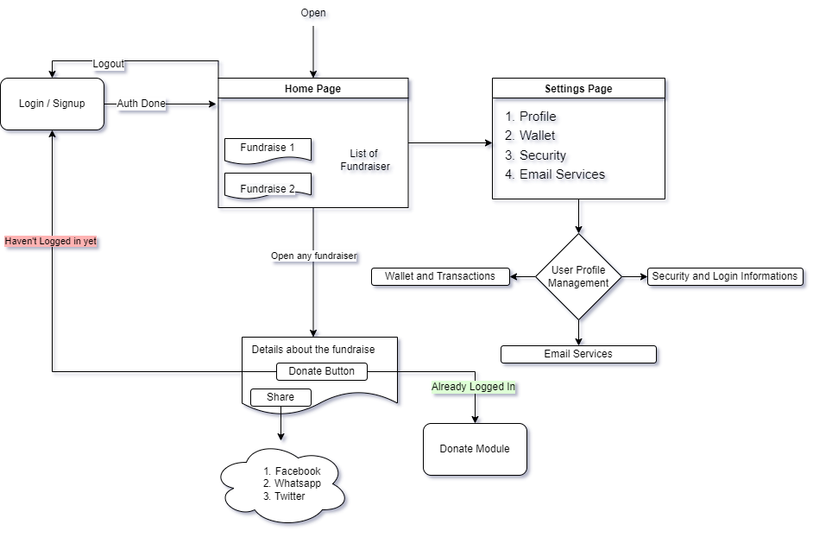
Application Flow

Slide 6
Key Points
1.Enhanced Session Management using IP and Login Information Tracking to ensure security for user accounts.

Slide 7
2. All incoming and outing transaction to the wallet will be recorded with the proper timestamp and also the information about the transaction.

Slide 8
3. To prevent replay attacks used google reCAPTCHA API in login and signup forms.

Slide 9
4. To make a fundraise simple and easy an elegant new fundraiser form was created.

Slide 10

Conclusion
So far we’ve completed backend API development and implemented the working model and enhanced the UI and added some security feature.
Now, we’re working in payment integration in wallet to add and withdraw money easily.
Thank You

